Slide 1
Understanding Layer 3 Redundancy
Notes:
This lesson explains solutions to routing problems in a local network with a redundant topology. One solution to these problems is explained through the router redundancy process. This lesson identifies HSRP (Hot Standby Router Protocol), VRRP (Virtual Router Redundancy Protocol), and GLBP (Gateway Load Balancing Protocol) as Layer 3 redundancy protocols. It also describes how to configure basic HSRP and use the appropriate show commands to confirm proper functionality.
Explain the operation of first hop redundancy protocols in a switched network.
Describe the operation of HSRP.
Configure HSRP.
Troubleshoot HSRP configuration issues.

Slide 2
Objectives
Upon completing this lesson, you will be able to meet these objectives:
Describe routing issues in connection to redundancy
Explain the router redundancy process and what happens when a failover occurs
Identify HSRP and VRRP as Layer 3 redundancy protocols
Configure basic HSRP
Describe the idea behind HSRP interface tracking
Describe the idea behind HSRP load balancing
Identify GLBP as a load-balancing redundancy protocol
Notes:
Explain the operation of first hop redundancy protocols in a switched network.
Describe the operation of HSRP.
Configure HSRP.
Troubleshoot HSRP configuration issues.

Slide 3
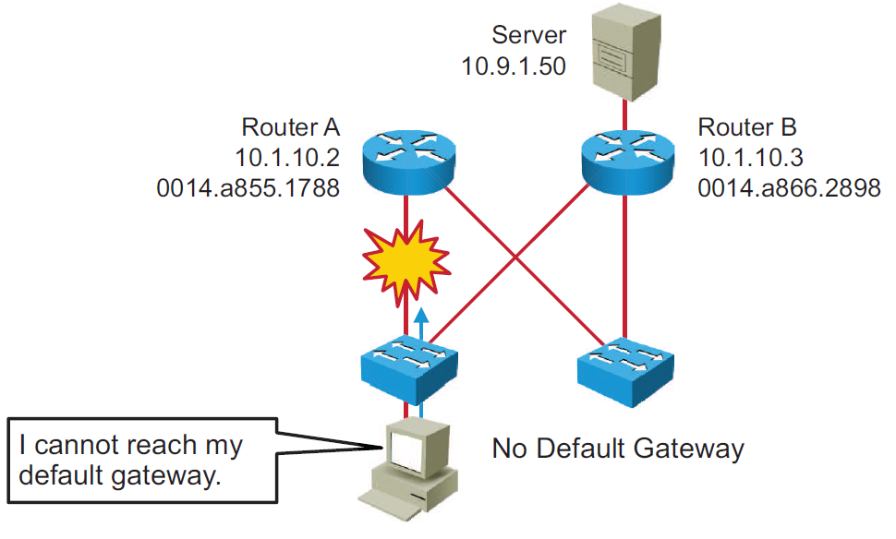
The Need for Default Gateway Redundancy
Notes:
Each client receives only one default gateway. There is no means by which to configure a secondary gateway, even if a second route exists to carry packets off the local segment.
For example, primary and secondary paths between the access layer equipment and the distribution layer switches provide continuous access in the event of a link failure between those two layers. Primary and secondary paths between the distribution layer switches and the core layer switches provide continuous operation if there is a failure between those two layers.
In this example, Router A is responsible for routing packets for Subnet A, and Router B is responsible for routing packets for Subnet B. If Router A becomes unavailable, the routing protocols can quickly and dynamically converge and determine that Router B will now transfer packets that would otherwise have gone through Router A. Most workstations, servers, and printers, however, do not receive this dynamic routing information.
End devices are typically configured with a single default gateway IP address that does not change when the network topology changes. If the router whose IP address is configured as the default gateway fails, the local device is unable to send packets off the local network segment, effectively disconnecting it from the rest of the network. Even if a redundant router exists that could serve as a default gateway for that segment, there is no dynamic method by which these devices can determine the address of a new default gateway.
Even though the example is explained on routers, in modern networks, these routers would actually be Layer 3 switches. These are high-performance devices for routing, but, in contrast to routers, they have many interfaces.

Slide 4
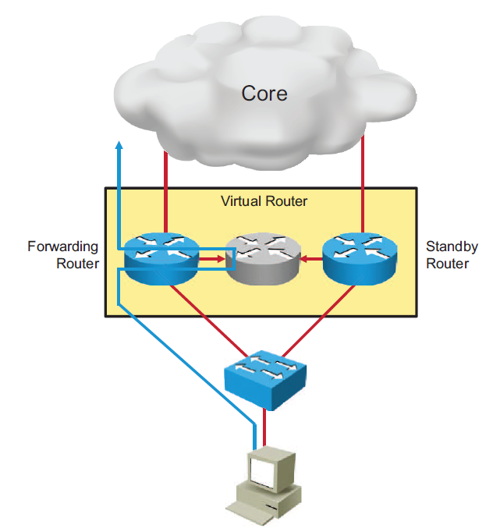
Default Gateway Redundancy
Notes:
With the type of router redundancy that is shown in the figure, a set of routers works together to present the illusion of a single router to the hosts on the LAN. By sharing an IP (Layer 3) address and a MAC (Layer 2) address, two or more routers can act as a single “virtual” router.
The IP address of the virtual router is configured as the default gateway for the workstations on a specific IP segment. When frames are sent from the workstation to the default gateway, the workstation will use ARP to resolve the MAC address that is associated with the IP address of the default gateway. The ARP resolution returns the MAC address of the virtual router. Frames that are sent to the MAC address of the virtual router can then be physically processed by any active or standby router that is part of that virtual router group.
A protocol is used to identify two or more routers as the devices that are responsible for processing frames that are sent to the MAC or IP address of a single virtual router. Host devices send traffic to the address of the virtual router. The physical router that forwards this traffic is transparent to the end stations.
The redundancy protocol provides the mechanism for determining which router should take the active role in forwarding traffic and determining when that role must be taken over by a standby router. The transition from one forwarding router to another is transparent to the end devices.

Slide 5
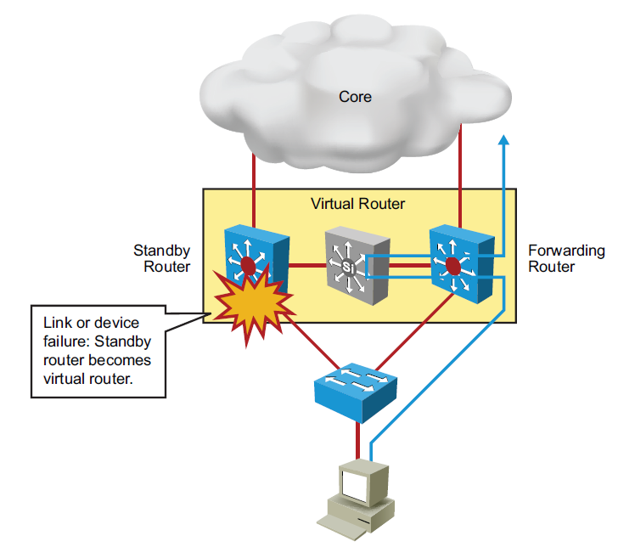
Default Gateway Redundancy (Cont.)
Notes:
These are the steps that take place when a router or Layer-3 switch fails:
The standby router stops seeing hello messages from the forwarding router.
The standby router assumes the role of the forwarding router.
Because the new forwarding router assumes both the IP and MAC addresses of the virtual router, the end stations see no disruption in service

Slide 6
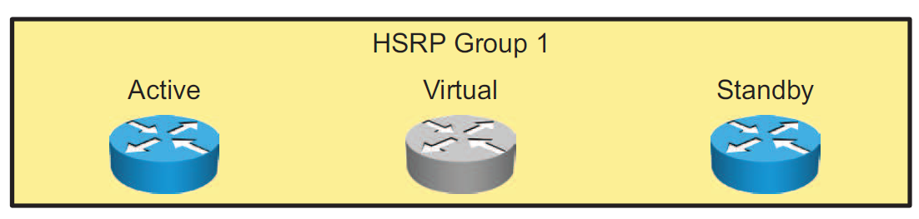
HSRP
HSRP defines a group of routers -- one active and one standby.
Virtual IP and MAC addresses are shared between the two routers.
To verify HSRP state, use the show standby command.
HSRP is Cisco proprietary, and VRRP is a standard protocol.
Notes:
HSRP defines a standby group of routers, with one router designated as the active router. HSRP provides gateway redundancy by sharing IP and MAC addresses between redundant gateways. The protocol consists of virtual MAC and IP addresses that are shared between two routers that belong to the same HSRP group.
HSRP Terminology
Active router: The router that is currently forwarding packets for the virtual router
Standby router: The primary backup router
Standby group: The set of routers participating in HSRP that jointly emulate a virtual router
The function of the HSRP standby router is to monitor the operational status of the HSRP group and to quickly assume packet-forwarding responsibility if the active router becomes inoperable.
HSRP is a Cisco proprietary protocol, and VRRP is a standard protocol. Beyond that, the differences between HSRP and VRRP are very slight.

Slide 7
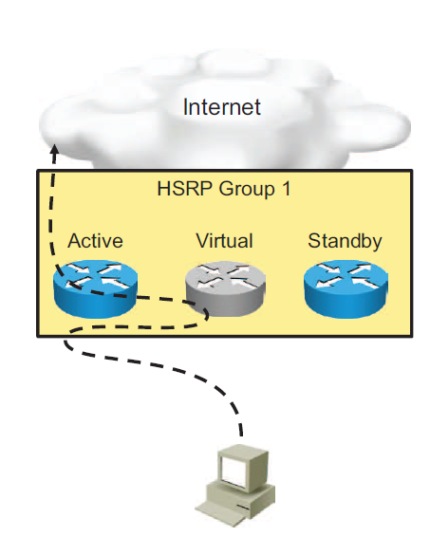
HSRP (Cont.)
Active router:
Responds to default gateway ARP requests with the virtual router MAC address
Assumes active forwarding of packets for the virtual router
Sends hello messages
Knows the virtual router IP address
Standby Router
Listens for periodic hello messages
Assumes active forwarding of packets if it does not hear from active router

Slide 8
Configuring HSRP
Routers A and B are configured with priorities of 110 and 90, respectively. The configuration of Router A is displayed. A similar configuration is required on Router B.
The preempt keyword ensures that Router A will be the HSRP active router as long its interface is active and sending hellos.
HSRP
Group 1
Router A
Priority
110
Router B
Priority
90
RouterA(config)# interface GigabitEthernet0/0
RouterA(config-if)# ip address 10.1.10.2 255.255.255.0
RouterA(config-if)# standby 1 ip 10.1.10.1
RouterA(config-if)# standby 1 priority 110
RouterA(config-if)# standby 1 preempt
Notes:
After configuring the IP address on the interface, use the standby group-number ip ip-address command to configure HSRP.
In HSRPv1, the group number can be any value between 0 and 255 but must be the same on both neighbour routers. In HSRPv2, the group number can be any value between 0 and 4095.
The IP address is that of the virtual router IP address for the HSRP group. It must be identical on all routers in an HSRP group.
Each standby group has its own active and standby routers. A network engineer can assign a priority value to each router in a standby group, thus controlling the order in which active routers for that group are selected. The default value is 100, but can be from 0 to 255.
During the election process, the router with the highest priority in an HSRP group becomes the active router. If a tie occurs, the router with the highest configured IP address becomes active.
If the routers do not have preempt configured, a router that boots up significantly faster than the others in the standby group becomes the active router, regardless of the configured priority. The former active router can be configured to resume the forwarding router role by preempting a router with a lower priority.

Slide 9
HSRP Verification
Use the show standby command to verify the HSRP state.
RouterA# show standby
GigabitEthernet0/0 - Group 1 (version 2)
State is Active
2 state changes, last state change 00:00:18
Virtual IP address is 10.1.10.1
Active virtual MAC address is 0000.0C9F.F001
Local virtual MAC address is 0000.0C9F.F001 (v2 default)
Hello time 3 sec, hold time 10 sec
Next hello sent in 2.278 secs
Preemption enabled
Active router is local
Standby router is 10.1.10.3, priority 90 (expires in 9 sec)
Priority 110 (configured 110)
Group name is hsrp-Gig0/0-1 (default)
Notes:
To display HSRP information, use the show standby command in privileged EXEC mode.
The example output shows the HSRPv2 state on the RouterA router. The IP of the virtual router is 10.1.10.1 and RouterA is actively routing traffic. By default, HSRP hellotime is 3 seconds and holdtime is 10 seconds.

Slide 10
HSRP Verification (Cont.)
The show standby brief command displays a summary of the HSRP configurations.
RouterA# show standby brief
P indicates configured to preempt.
|
Interface Grp Pri P State Active Standby Virtual IP
Gig0/0 1 110 P Active local 10.1.10.3 10.1.10.1

Slide 11
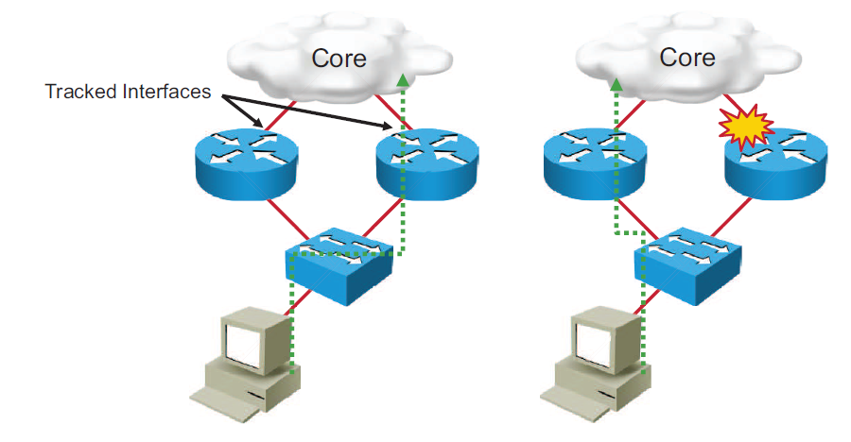
HSRP Interface Tracking
Notes:
Interface tracking enables the priority of a standby group router to be automatically adjusted based on the availability of the router interfaces. When a tracked interface becomes unavailable, the HSRP tracking feature ensures that a router with an unavailable key interface will relinquish the active router role.
The HSRP group tracks the uplink interfaces. If the uplink on the right switch fails, the router automatically decrements the priority on that interface and sends hello messages with the decremented priority.
Assume that, in the example in the figure, the router on the right is configured with a higher priority, and therefore is handling the traffic toward the core. As soon as the interface through the router on the right fails, the host will be unable to reach the core network. HSRP will make the router on the left the active router.

Slide 12
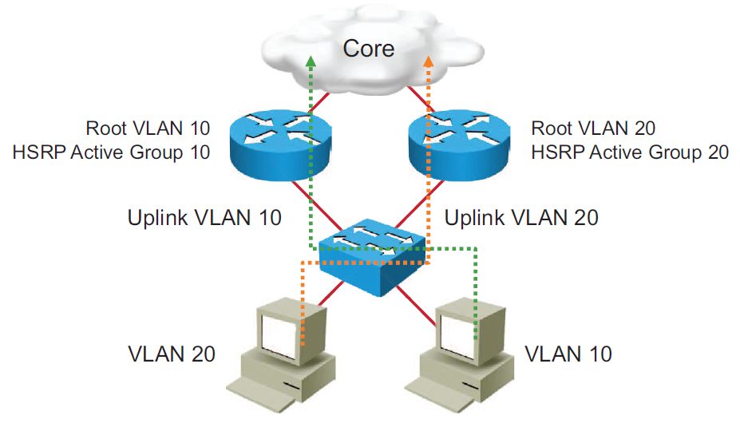
HSRP Load Balancing
Notes:
Routers can simultaneously provide redundant backup and perform load sharing across various subnets.
In the figure, two HSRP-enabled routers participate in two separate VLANs. Running HSRP over trunks allows users to configure redundancy among multiple routers.
By configuring HSRP over trunks, you can eliminate situations in which a single point of failure causes traffic interruptions. This feature inherently provides some improvement in overall networking resilience by providing load-balancing and redundancy capabilities between subnets and VLANs.

Slide 13
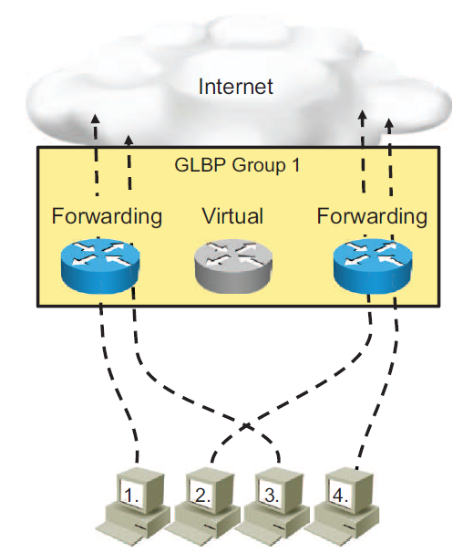
Gateway Load Balancing Protocol
Allows full use of resources on all devices without the administrative burden of creating multiple groups
Provides a single virtual IP address and multiple virtual MAC addresses
Routes traffic to single gateway distributed across routers
Provides automatic rerouting in the event of any failure
Notes:
Although HSRP and VRRP provide gateway resiliency, for the standby members of the redundancy group, the upstream bandwidth is not used while the device is in standby mode.
Only the active router in HSRP and VRRP groups forwards traffic for the virtual MAC address. Resources that are associated with the standby router are not fully utilized. You can accomplish some load balancing with these protocols by creating multiple groups and assigning multiple default gateways, but this configuration creates an administrative burden.
GLBP is a Cisco proprietary solution to allow automatic selection and simultaneous use of multiple available gateways, in addition to automatic failover between those gateways. Multiple routers share the load of frames that, from a client perspective, are sent to a single default gateway address.
With GLBP, you can fully utilize resources without the administrative burden of configuring multiple groups and managing multiple default gateway configurations.

Slide 14
Gateway Load Balancing Protocol (Cont.)
R1#show glbp
FastEthernet0/0 - Group 1
State is Active
2 state changes, last state change 00:04:12
Virtual IP address is 192.168.2.100
<output omitted>
Active is local
Standby is 192.168.2.2, priority 100 (expires in 7.644 sec)
Priority 100 (default)
Weighting 100 (default 100), thresholds: lower 1, upper 100
Load balancing: round-robin
Group members:
c000.0ce0.0000 (192.168.2.1) local
c001.0ce0.0000 (192.168.2.2)
<output omitted>
The show glbp command in this example displays information about the status of GLBP group 1.
Notes:
To display GLBP information, use the show glbp command in privileged EXEC mode.
The example output shows that the virtual router IP address is 192.168.2.100 and that one router is in the Active state and the other router is in the Listen state. "Active" indicates that this router is responsible for responding to ARP requests for the virtual IP address. "Listen" indicates that the router is receiving hello packets and is ready to be activated if the currently active router fails.

Slide 15
Gateway Load Balancing Protocol (Cont.)
R1#show glbp
<output omitted>
There are 2 forwarders (1 active)
Forwarder 1
State is Active
1 state change, last state change 00:04:02
MAC address is 0007.b400.0101 (default)
Owner ID is c000.0ce0.0000
Redirection enabled
Preemption enabled, min delay 30 sec
Active is local, weighting 100
Forwarder 2
State is Listen
The show glbp command in this example displays information about the status of GLBP group 1.

Slide 16
Summary
End devices are typically configured with a single default gateway IP address that does not change when the network topology changes.
Redundancy protocols provide a mechanism for determining which router should take the active role in forwarding traffic and determining when that role must be taken over by a standby router.
HSRP defines a standby group of routers, with one router as the active router. VRRP is standard protocol that provides a similar function.
GLBP is a Cisco proprietary solution to allow automatic selection and simultaneous use of multiple available gateways in addition to automatic failover between those gateways.

